Slide 1
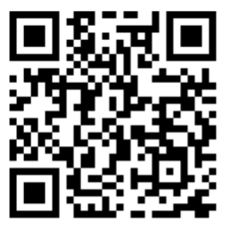
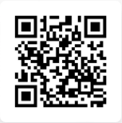
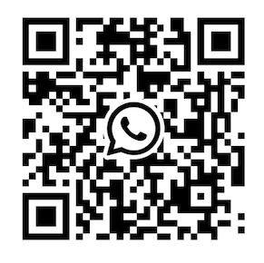
Contact PAC / Stay in touch
2. Byng PAC website: https://www.lordbyngpac.com/
1. Email PAC:
lordbyngschoolpac@gmail.com
(English or 中文)
3. PAC Newsletter Sign Up 訂閱 http://eepurl.com/iyRCtI
4. All Byng Parents WhatsApp Group https://chat.whatsapp.com/GV7pXm7C5aFLJYpeX5mERq?mode=ems_wa_t

Slide 2
2026-2027 Byng Administration
Krista Ediger - Principal
Albert Mann - Vice-Principal
Diane Phillips - Vice-Principal

Slide 3
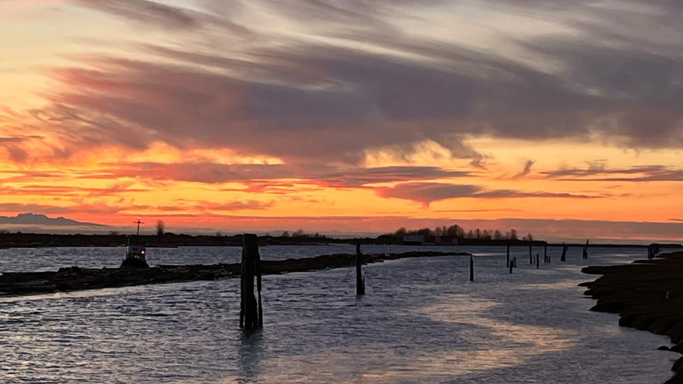

LAND ACKNOWLEDGEMENT
With deep gratitude and respect, we are honoured to be learning and unlearning on the ancestral and unceded lands of the xʷməθkʷəy̓əm (Musqueam Nation).
xʷməθkʷəy̓əm

Slide 4
LORD BYNG PAC MEETING
September 22th, 2026
Lord Byng Secondary School Library
6:30-8pm
Zoom simulcast
Meeting ID: 791 735 6765
Password: awesome

Slide 5

Agenda
Time 时间K | Duration 时长 | Description 内容 | Speaker 发言人
6:30 pm | 5 min | Welcome and introductions 欢迎和介绍 | Jacqueline uuuumey PAC主席
6:35 pm | 5 min | What is PAC? 什么是 PAC | Jacqueline Crummey PAC主席
6:40 pm | 10 min | Principal Update 校长发言 Dr. David Robinson | Principal Krista Ediger Artist PhD., Experimental Medicine
6:50 pm | 30 min | PAC 2025–2026 Overview & Finances PAC 2025-2026 年度回顾 | PAC Exec PAC 执委
7:20 pm | 5 min | 2027 Grad Committee 毕业生委员会 | Grad Committee 毕业生委员会
7:25 pm | 10 min | 2027 PAC Exec Elections & Roles, Subcommittees 2027 PAC选举 | Jacqueline Crummey PAC主席
7:35 pm | 15 min | Announcements General Q & A 通知，提问和回答 | Jacqueline Crummey PAC主席
7:50 pm |  | Meeting adjourned 会议结束
Meeting Date（会议日期）:
September 22, 2026,
6:30pm – 8pm
Location（地点）:
Lord Byng Library & Zoom
Chair（主席）:
Jacqueline Crummey

Slide 6
2025-2026 Byng Parent Advisory Committee Exec
Chair:Jacqueline Crummey
Vice Chair: Juli Carrillo & Michelle Tseng (shared responsibilities)
Secretaries: Qian Wang and Sunny Wang (shared responsibilities)
DPAC reps: Sunny Li and Fiona Shaw
Treasurer: Yue Ma (Jasmin)
Members at Large: Caroline Cheung, Angela Gao, Cindy Groner, Bilge Ataca MacDonald, Marco Feller, Su Jin Chun, Jacqueline Li, Serena Naramore, Jenny Xu, Shelley Zhao, Dikla Barer, Nora Ng, Claudette Lauzon, Mois Shi, Mark Wang, Michael Stephen, Leticia Martin
​Past Chair: May Lee

Slide 7
PAC = Collective voice of parents
All Byng parents and guardians are members of the PAC
Elected executive committee (PAC Exec)
Work with families to address concerns that impact the whole school community

Slide 8
PAC: Supports Byng families
Host regular PAC meetings for parents
Provide updates on the PAC website
Host special education speakers (e.g. Vaping, Local Industry Professionals)
Host walks, coffee time, and teacher appreciation lunch in June

Slide 9
PAC: Supports Byng families
Share updates from the VSB and participate in DPAC (District PAC for the VSB)
Support Grad Committee for graduation events
Support Byng Arts families

Slide 10
PAC: Supports the school
Support parent information nights including: course planning, capstone, and grade 12 post-secondary evenings
Fundraise to enhance our school
Apply for and administer the BC Gaming Grant

Slide 11
Principal’s update
校长发言

Slide 12

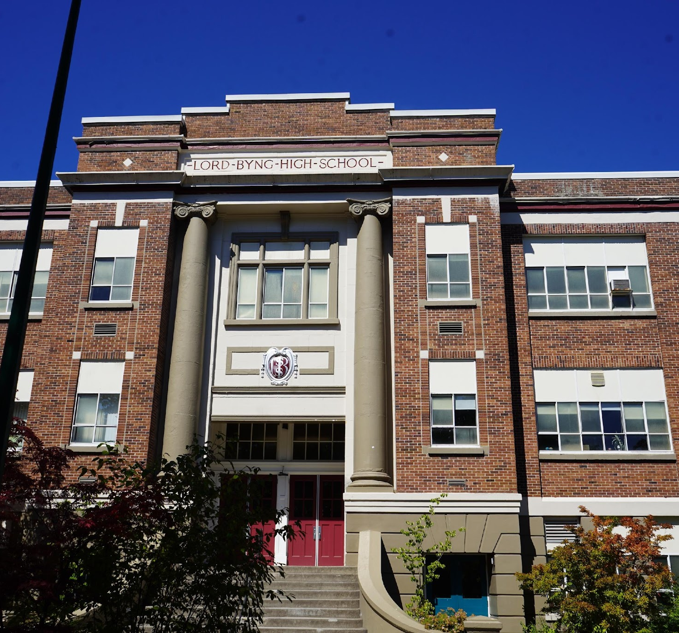
PAC Mtg
Update
Tue, Sept 22

Slide 13
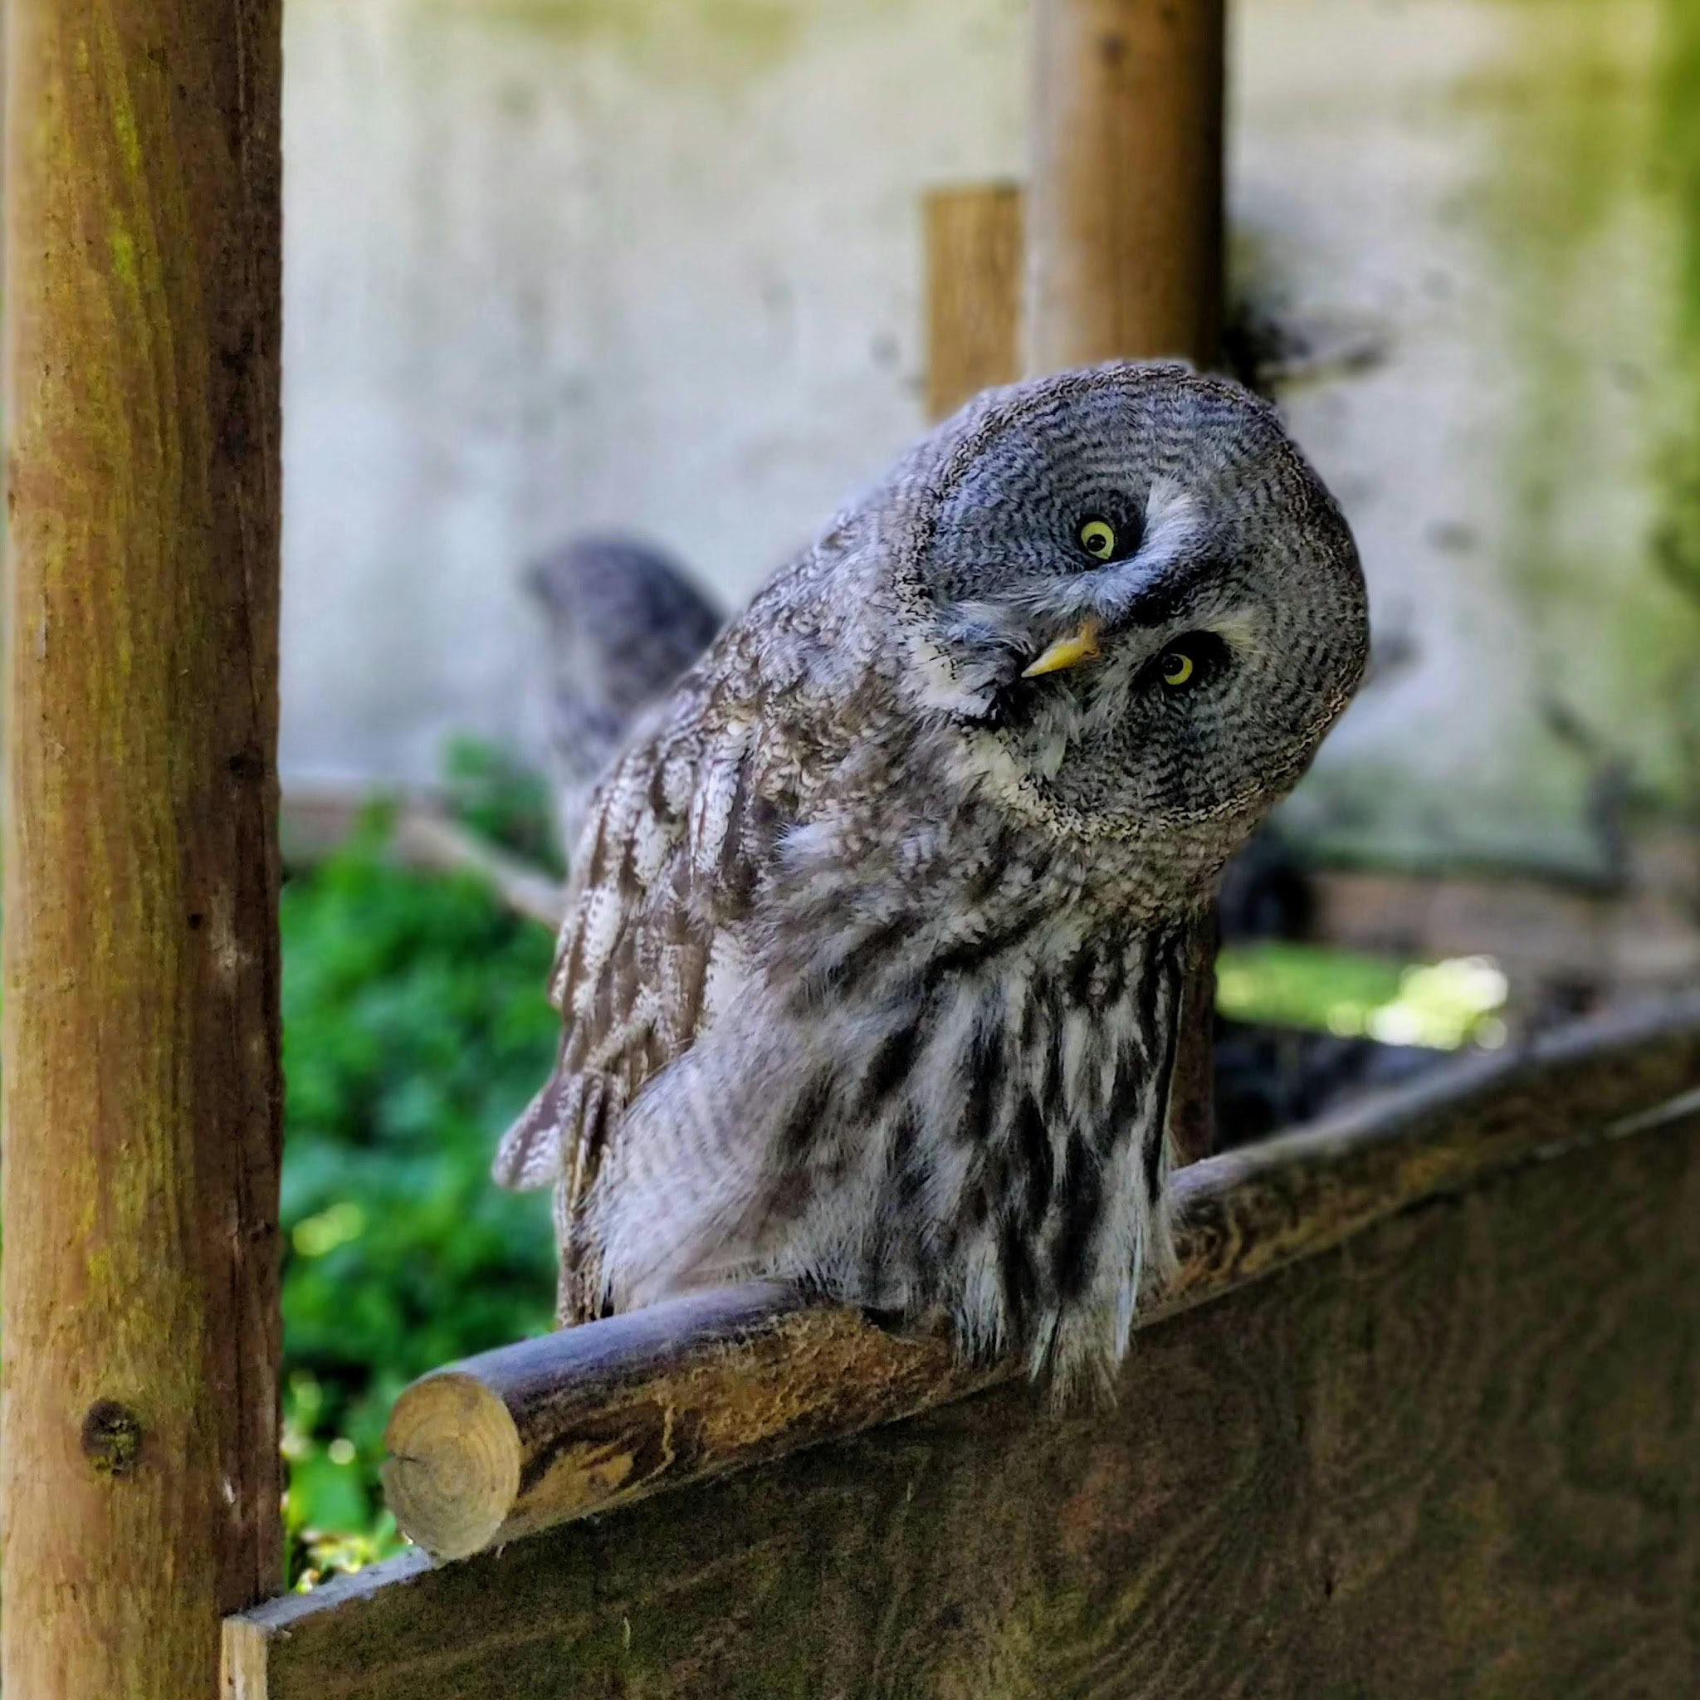
When people are curious about something, they learn more and they learn it better.
–S. Engel

Slide 14
Lord Byng PAC 2025-2026 Review

Slide 15
PAC 2025-2026 Overview
1: CORE GOVERNANCE & OPERATIONS
1.1 PAC Meetings & Executive Oversight
1.2 Financial Stewardship, Grants & Fundraising
2: FOR PARENTS — ENGAGEMENT & SOCIAL CONNECTION
2.1 Parent Education, Speaker Series & Workshops
2.2: Parent Wellness & Community Building
3: WORKING WITH STAFF & STUDENTS
3.1 School Staff Recognition & Appreciation
3.2 Graduation & Student Milestone Celebrations

Slide 16
CORE GOVERNANCE & OPERATIONS
PAC General Meetings & Elections
September 17, 2025: PAC Introduction
October 22, 2025: PAC General Meeting & Executive Elections
November 19, 2025: Budget Approval & Wishlist Review
January 21, 2026: BC Gaming Grant Allocations & Financial Update
February 25, 2026: General Meeting & Department Updates
April 14, 2026: Off-Site PAC Meeting (Paul Kyle Gallery)
May 20, 2026: Final Year-End PAC General Meeting

Slide 17
CORE GOVERNANCE & OPERATIONS
BC Gaming Grant Application and Allocation
2025–2026 BC Gaming Grant Allocation
  Total Grant Funds Available in Account: $33,077.30
  Total Requested by Teachers/Clubs: $105,730.67 (30+ individual funding requests)
2026-2027 BC Gaming Grant Application
  Estimated Grant Amount: $29,900 (by the PAC Treasurer Jasmin Ma)
Direct Fundraising Campaigns
PAC Direct Appeal Campaign (Dec 2025 – May 2026): School-wide annual fundraising drive.
  Fundraising Goal: $25,000 (~$30–$50 suggested per family).
  Amount Raised: $16,555.00 in direct parent donations (plus $2,117.47 carryover balance from the previous year, bringing total available funds to $18,672.47).
  Targeted & Funded Items: Funded ~ $18,200 of key school priorities, including auditorium lighting upgrades, outdoor classroom furniture/seating, athletic equipment & banquet support, and student clubs (such as Bike Mechanics and Garden Club).

Slide 18
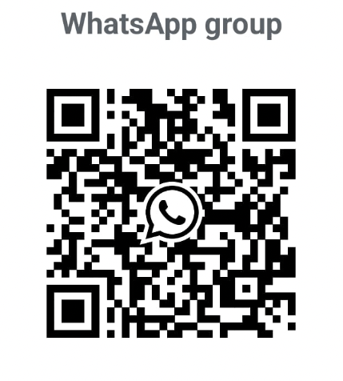
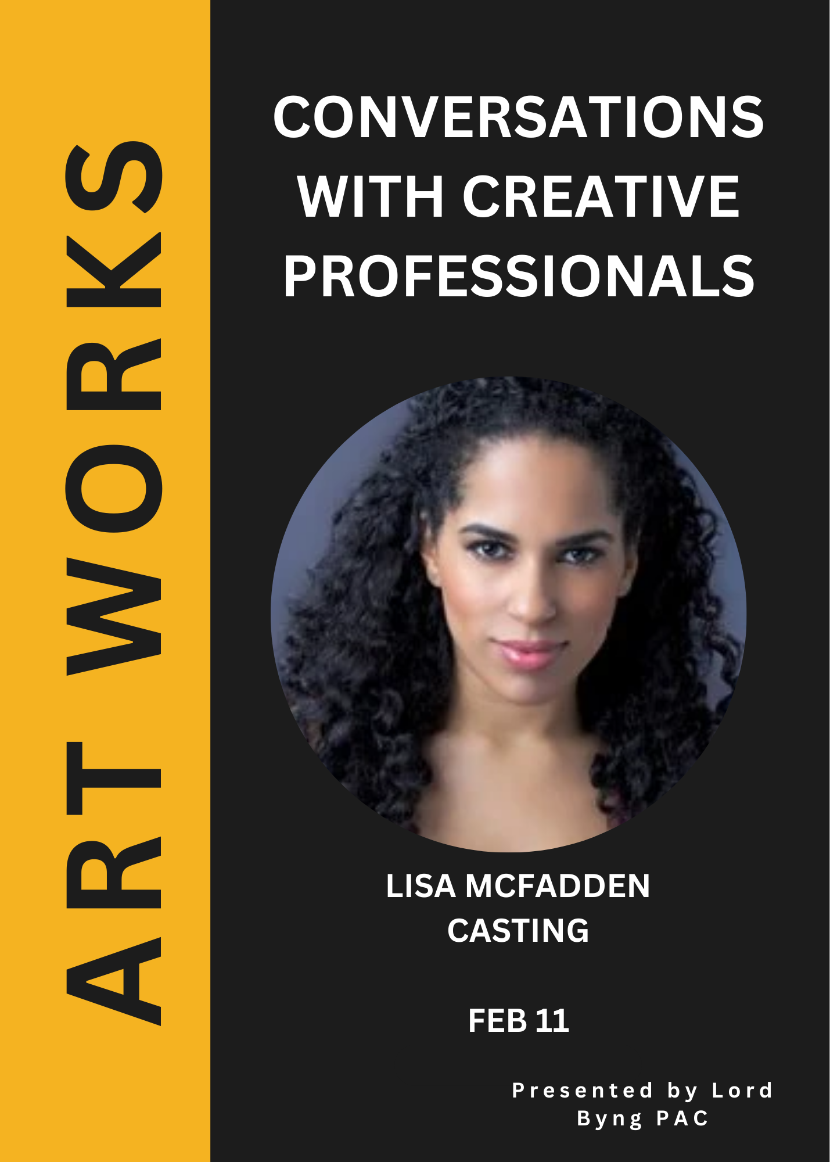
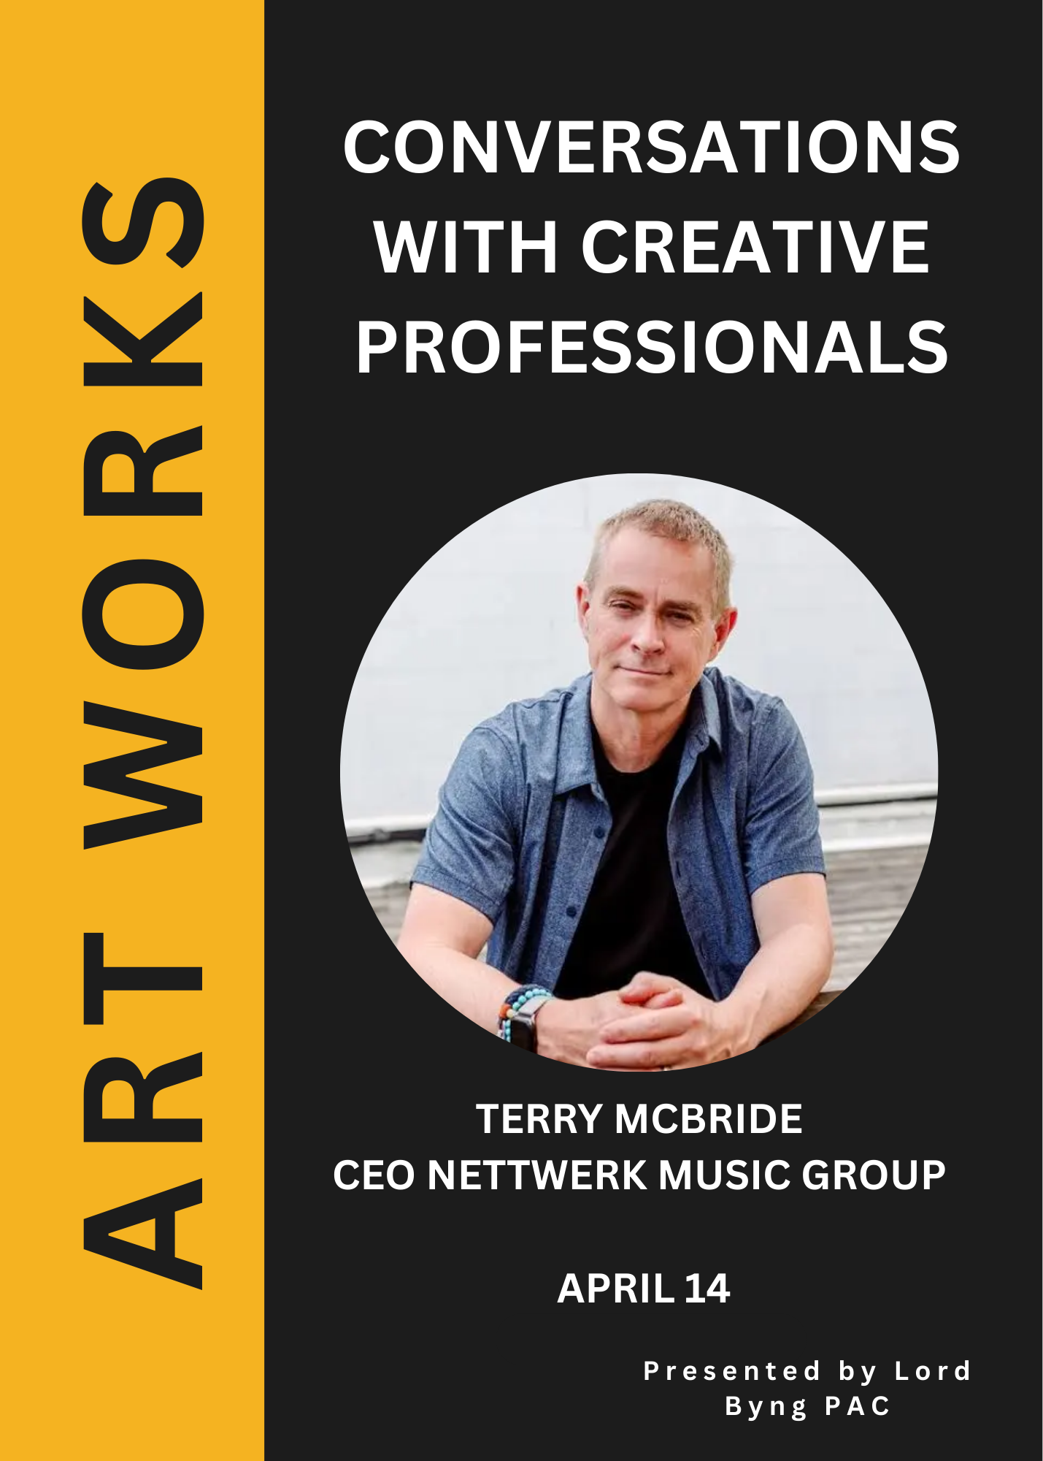

FOR PARENTS — ENGAGEMENT, LEARNING & SOCIAL CONNECTION
Parent Education Series & Workshops
2026 Art Works Speaker Series (Juli and Michelle)
Feb 11 - Lisa Mcfadden, Casting Director
Apr 14 - Terry McBride, CEO Nettwerk
June 10 - Sara Gillingham, Ben Skinner - Illustrator / Author / Creative Directors
Other Workshops for Parents
May 20, 2026: VSB SACY Presentation on Youth Substance Use Prevention (Hayden Averill)
June 11, 2026: SACY "Building Bridges" Caregiver Workshop (Tupper Secondary)

Slide 19
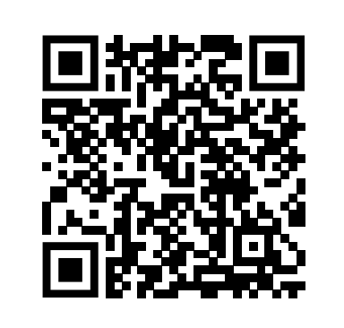
FOR PARENTS — ENGAGEMENT & SOCIAL CONNECTION
Wellness & Community Building - Nora Ng with the help of other PAC members
Recreation & Wellness
Thursday Parent Walking Group: Weekly at 9:00 AM
Sun Run Training Group: Weekly running/walking sessions before Sun Run
Community Gatherings & Social Events
February 19, 2026: Lunar New Year Dim Sum Lunch
February 25, 2026: "A Glimpse of Lord Byng" Parent School Tour
June 4, 2026: Year-End Parent Dim Sum Lunch
June 12, 2026: Year-End Parent Coffee Social
September 18, 2026 Welcome Back PAC coffee meeting
PAC website and PAC newsletter
Jenny Xu updating and maintaining PAC website
Su-Jin (and others) prepare PAC newsletters
Join WhatsApp with Nora by scanning the code below.

Slide 20
WORKING WITH STAFF & STUDENTS
Lord Byng Staff Appreciation Luncheon:
  June 11, 2026 – Annual PAC luncheon serving ~120 staff members, featuring parent-contributed dishes, catering, a gift lucky draw, handwritten thank-you cards, and $25 gift cards for all staff.
Graduation & Student Milestone Events (Led by PAC Grad Sub-Committee)
Focus: Direct planning, fundraising, and execution of year-end celebrations for Grade 12 students by the PAC Grad Sub-Committee.
Grad Fundraising Initiatives & Bottle Drive: Launched January 26, 2026
Grad Dinner & Dance: May 30, 2026 (Westin Bayshore)
Grad Prom: June 6, 2026 (Dockside Restaurant)
  Organized by school: Commencement Ceremony: June 5, 2026 (Chan Centre for the Performing Arts)

Slide 21
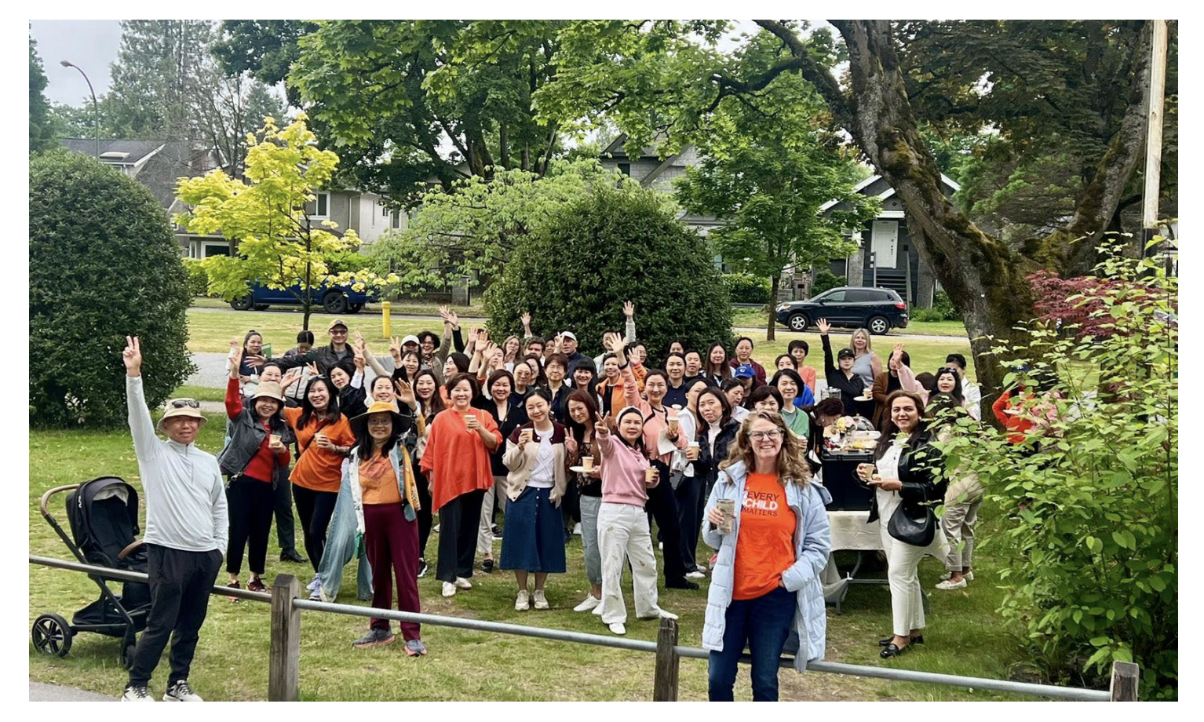
PAC 2025-2026 Overview

Slide 22
Treasurer’s Report — Sept. 19, 2026
A. Opening Balances
Account Opening Balance（Last meeting May 18th）
General Account $4846.32
Grad Account $3809.41
Gaming Account $30577.30
B. Income and expense
General Account:
Credit:
$5908 Staff Appreciation Lunch donation into General Account
Debit:
$4680.95 Staff Appreciation Lunch reimbursement from General Account
$416.76 Wix service from General Account
$100 BCCPAC from General Account
$9 E-transfer service fee
Grad Account:
Debit:
$ 1,856.86, last reimbursement
$0.9 E-transfer service fee
Gaming Account:
Plan to debit: $24,130.44 to school soon
C. Closing Balances
Calculated for each account:
Account Closing Balance (Sept. 18th)
General Account $5634.78
Grad Account $1951.65
Gaming Account $30577.30

Slide 23
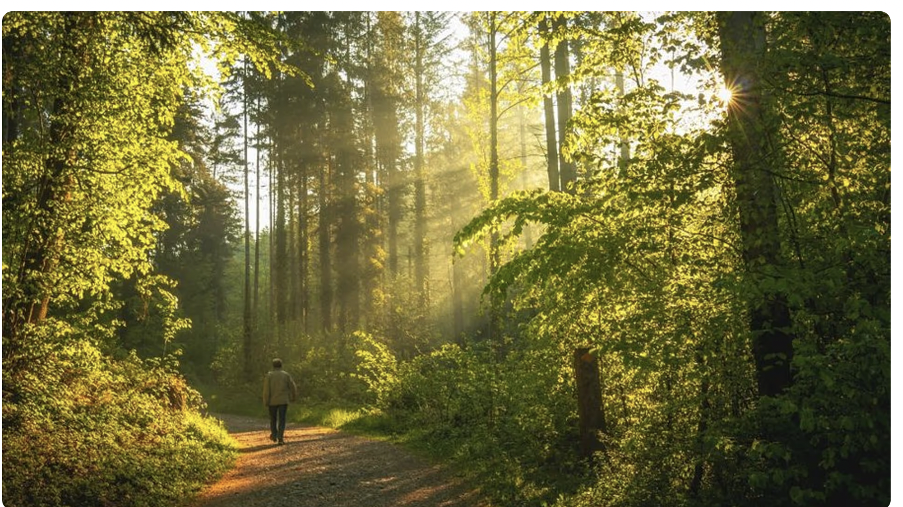
Wednesday Walks - Nora Ng
Image from ecotree.green

Slide 24
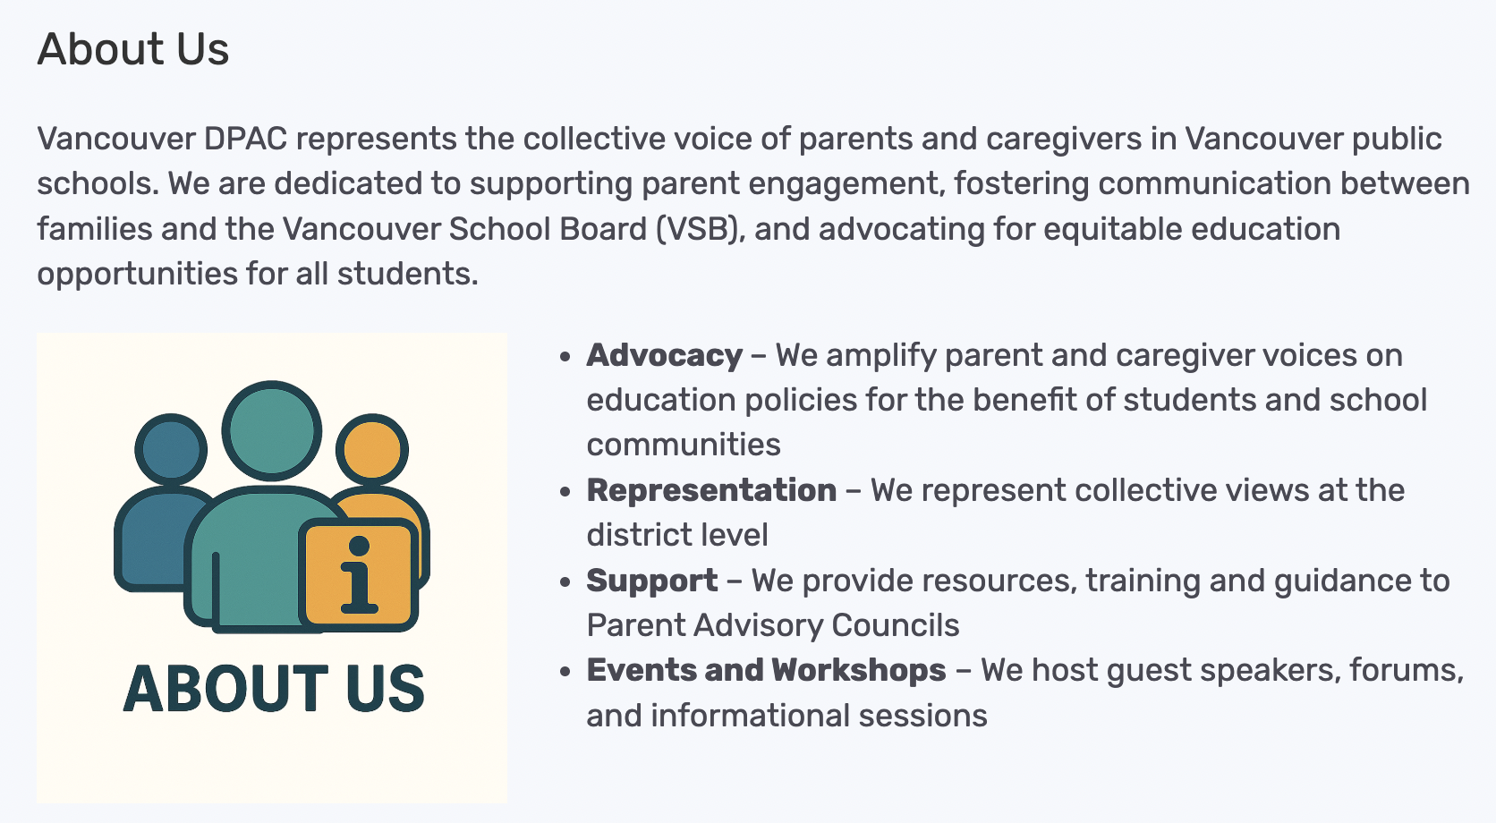
District PAC (DPAC)区家委会信息更新
https://www.vancouverdpac.org/about-us/

Slide 25
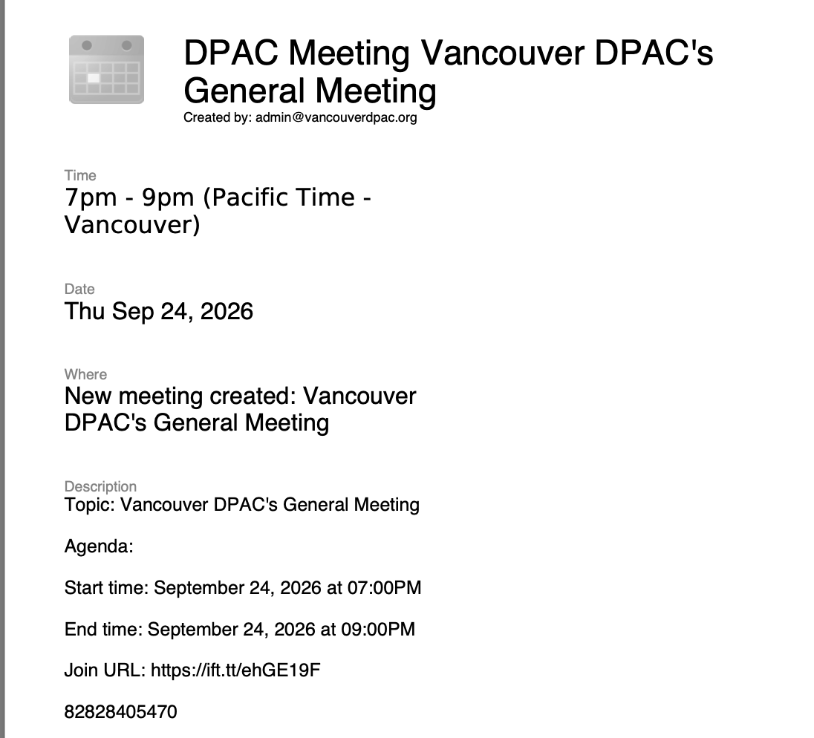
DPAC Updates
区家委会信息更新
DPAC GENERAL MEETINGS: meetings are open to all parents to attend. Be informed & get involved to help support our schools and kids! Website: https://www.vancouverdpac.org/
All parents and caregivers of public school students in Vancouver are welcome to join or start a WORKING GROUP, it’s a great way stay informed about what is happening in our district as a whole. Some examples of current DPAC groups:
*Active Transportation Safe Routes
*Food Framework
*Health & Safety
*Inclusive Education Working Group
Upcoming: Sept 24th at 7pm-8pm via Zoom
Register in advance at: http://www.vancouverdpac.org.

Slide 26
Grad Committee Update
毕业生委员会信息更新
GRAD 2026 PARENT COMMITTEE VOLUNTEERS NEEDED:
Co-Chairs (in 2026 we had 3 people share this role),
Treasurer
Fundraising Co-Ordinator
Communications Person (to send emails to the grad parents about the fundraisers and events).
If you are interested in volunteering, please contact Jacqueline Crummey
email: lordbyngschoolpac@gmail.com
WhatsApp Group: https://chat.whatsapp.com/G5mUp3FdGBX1W34L7midQf?s=sw&p=i&mlu=4&ilr=4
Welcome to join our first meeting on Tuesday, October 6th at 7pm @ Lord Byng library

Slide 27
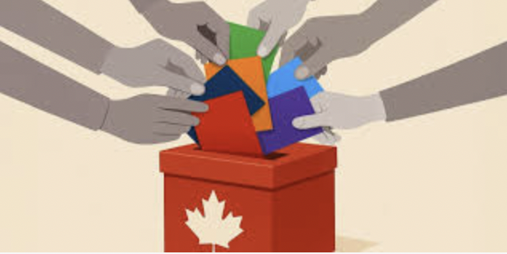
October 2026 PAC Annual Election
Chair or Co-Chair
Vice Chair
Treasurer
Secretary
DPAC Representative
Members at Large
All PAC Executive and Member-at-Large roles are currently recruiting
  Any Byng parent/guardian can run
  Previous PAC experience is helpful but not required
Members-at-Large
  are elected and voting members who support events and committees, and
  bring a broader range of parent perspectives to PAC decisions.

Slide 28
PAC Exec Roles (5 positions)
Chair or Co-Chair: Organize and attend meetings, read & understand bylaws, liaise with administration; consult parents, signing officer
Vice Chair: Assist Chair, signing officer

Slide 29
PAC Exec Roles (5 positions)
Treasurer: Oversee PAC accounts, receive funds, deposit funds; reconcile accounts, annual report, submit gaming grant and reports
Secretary: Take minutes at meetings, organize PAC communications and records
DPAC Rep: Attend DPAC (District PAC) meetings

Slide 30
PAC ‘Members at Large’ join subcommittees
BYNG ARTS - Byng Arts specific engagement & support
SAFETY - Keep track or safety-related issues around Byng;
INCLUSION & DIVERSITY - Forum for supporting diversity, inclusion and belonging at Byng. Contact: Jacqueline Crummey
FUNDRAISING AND EVENTS - Help run fundraising and school events
OTHERS - possible new/different subcommittees this year

Slide 31
General Q & A
提问和回答

Slide 32
Byng & PAC Announcements
PAC Executive & Member-at-Large recruitment underway
  Chair or Co-Chair
  Vice Chair
  Treasurer
  Secretary
  DPAC Representative
  Members at Large
Grad 2027 updates — to come
Wednesday Walks
  All Parents are welcome.
  Starting in front of the main steps in front of Lord Byng at 9am every Wednesday. We walk either the forest or the beach. Walks usually end by 10:30 and we can have coffee afterwards. It's a great way to meet other parents" if you have questions please contact noradyng@hotmail.com

Slide 33
Byng & PAC Upcoming Events
PAC meeting dates for 2026-2027
Sept. 22: First PAC Meeting, 6:30–8:00pm — Library
All future PAC meetings will be on Wednesday, not Tuesday, from 6:30-8:00pm in person. Online options may be available for future meetings.
October 20 2026
⁠Weds Oct 21st: PAC annual election / AGM
⁠⁠Thurs Nov 19th
⁠⁠Monday Jan 18th
⁠⁠Tues Feb 23rd
⁠⁠Weds April 14th
⁠⁠Thurs May 13th

Slide 34
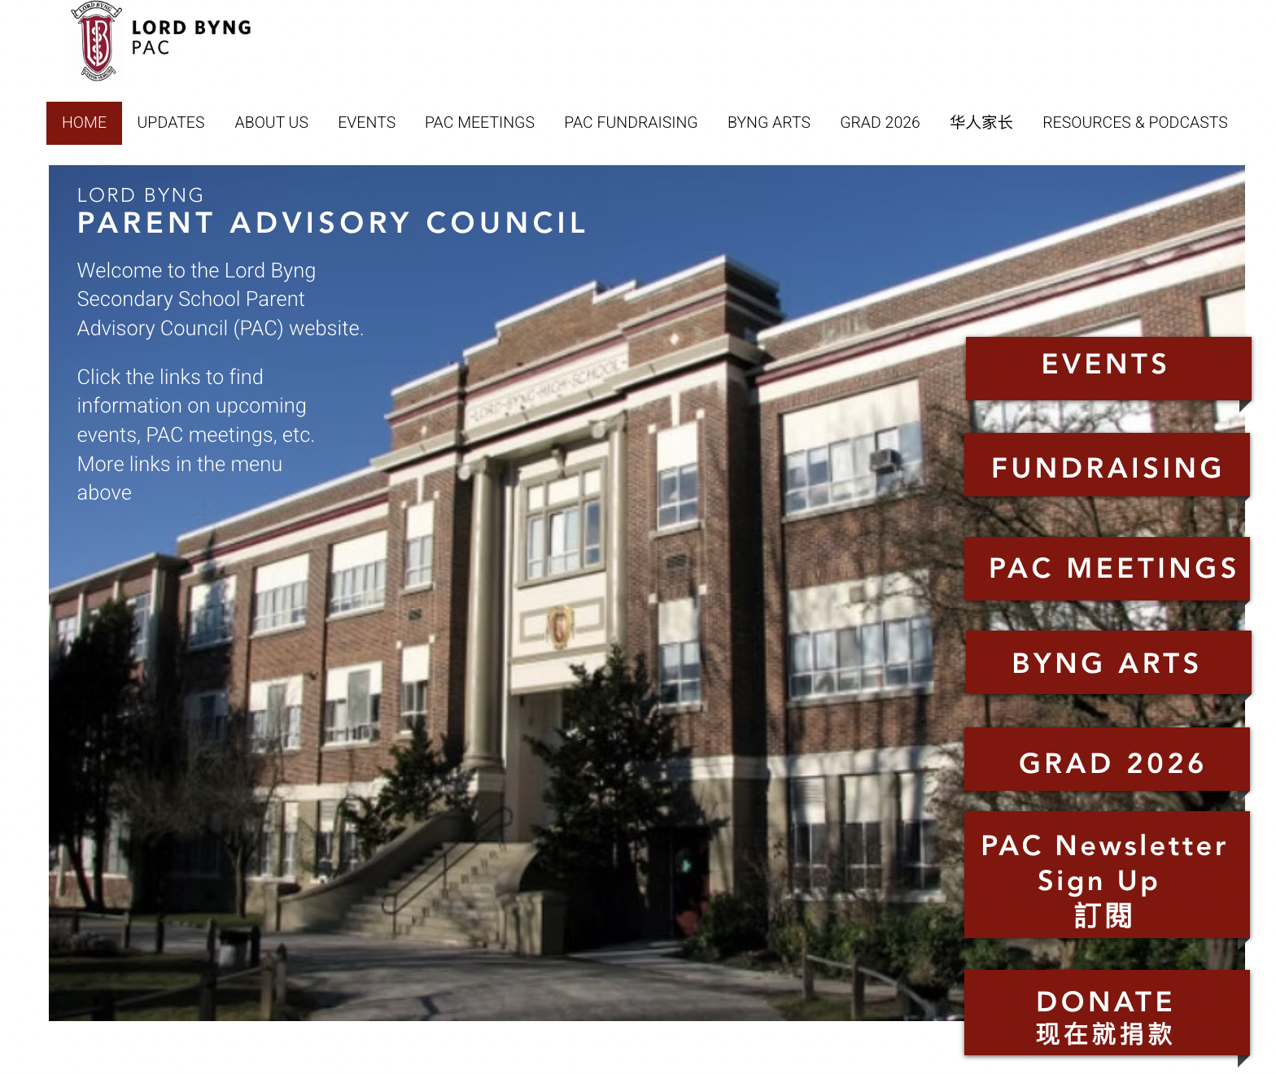
PAC website: https://www.lordbyngpac.com/
PAC email: lordbyngschoolpac@gmail.com

Slide 35
Contact PAC / Stay in touch
2. Byng PAC website: https://www.lordbyngpac.com/
1. Email PAC:
lordbyngschoolpac@gmail.com
(English or 中文)
3. PAC Newsletter Sign Up 訂閱 http://eepurl.com/iyRCtI
4. All Byng Parents WhatsApp Group https://chat.whatsapp.com/GV7pXm7C5aFLJYpeX5mERq?mode=ems_wa_t

